Slide 1

GOLF / GOLF ON CLOUDFLARE
A Git platform built on Cloudflare.
A native Git workflow across the Cloudflare platform.
GOLF / DEVELOPER PREVIEW / OCTOBER 2026
1 / 43
Notes:
Golf developer preview. Evidence and binding review October 14, 2026. This conceptual cover illustration is not a system diagram. Audience: Golf on Cloudflare.
Reviewed product evidence: 2026-10-14. https://docs.gitgolf.app/docs/status/

Slide 2
THE PRODUCT
From source to software.
Golf connects Git, collaboration, executable evidence, optional proposals and protected previews.
01
02
03
Source
Evidence
Delivery
Repositories, history, issues, PRs and human review.
Approved exact-source tests, reports and proposals.
Protected static and bounded Worker app previews.
GOLF / DEVELOPER PREVIEW / OCTOBER 2026
2 / 43
Notes:
Golf connects Git, collaboration, executable evidence, optional proposals and protected previews.
Reviewed product evidence: 2026-10-14. https://docs.gitgolf.app/docs/status/

Slide 3
DEPLOYMENT / DOCKER
Docker: the portable Golf stack.
Run a complete developer core on your machine or owned Docker infrastructure.
01
02
03
What runs
How to start
What you own
Golf React/Go, Forgejo and independent PostgreSQL databases/roles. Private configuration and persistent volumes survive ordinary restarts.
Initialize private environment files, start Compose, check /readyz, then enroll a mapped Golf account. Optional Docker workers, agents and object storage require their own setup.
Image/version choices, HTTPS beyond loopback, secrets, data volumes and coordinated recovery. No Cloudflare or AI account is needed for core work.
GOLF / DEVELOPER PREVIEW / OCTOBER 2026
3 / 43
Notes:
Full quick start: https://docs.gitgolf.app/docs/installation/ . Current image internal paths retain native directory names; component and provider are Forgejo. Never routinely delete retained volumes.
Reviewed product evidence: 2026-10-14. https://docs.gitgolf.app/docs/status/

Slide 4
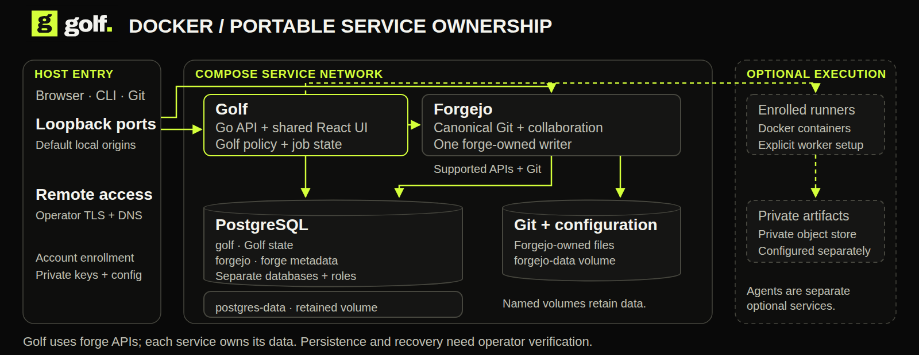
DEPLOYMENT / DOCKER
Docker: what runs, what persists.
The portable core uses Forgejo and PostgreSQL. Execution workers are allocated separately.
GOLF / DEVELOPER PREVIEW / OCTOBER 2026
4 / 43
Notes:
Full quick start: https://docs.gitgolf.app/docs/installation/ . Current image internal paths retain native directory names; component and provider are Forgejo. Never routinely delete retained volumes. This diagram shows ownership and placement. Optional services require their own configuration.
Reviewed product evidence: 2026-10-14. https://docs.gitgolf.app/docs/status/

Slide 5
DEPLOYMENT / KUBERNETES
Kubernetes: deploy Golf deliberately.
Golf’s Helm chart packages the portable core and makes its operating boundaries explicit.
01
02
03
What the chart supplies
How it is hardened
What you supply
Golf replicas, one Forgejo writer, optional PostgreSQL, resources/probes, retained claims, non-root isolation and default-deny policies.
Upgrade identity/endpoint fences, API hostname spread and multi-replica disruption budget, graceful drain, private database CA mounts and explicit DNS/egress peers.
Built image, existing credential/certificate Secrets, enforcing CNI, storage, ingress/TLS/DNS and a tested recovery procedure. Runners and agent services remain separate.
GOLF / DEVELOPER PREVIEW / OCTOBER 2026
5 / 43
Notes:
Complete guide: https://docs.gitgolf.app/docs/kubernetes/ . Chart 0.2.0 passed a fresh one-node k3d runtime proof on 2026-10-14: two API replicas, private Git and immutable source, cross-replica sessions/revocation, restart persistence, enforced network denials, external dependencies, identity refusal and retained claims. Extra API replicas do not make Forgejo/storage/database highly available. Multi-node failover, public ingress/TLS, CA rotation and full recovery remain open.
Reviewed product evidence: 2026-10-14. https://docs.gitgolf.app/docs/status/

Slide 6
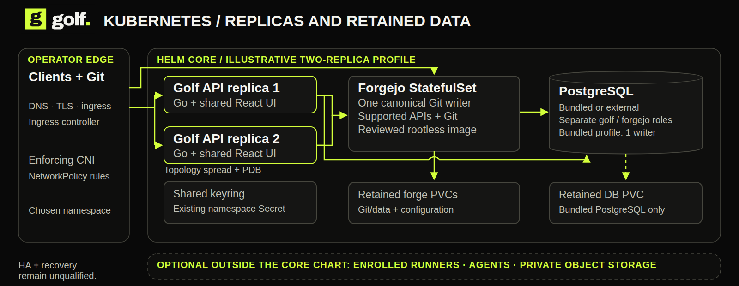
DEPLOYMENT / KUBERNETES
Kubernetes: placement and ownership.
API replicas share one forge writer and retained storage. More replicas alone do not establish HA.
GOLF / DEVELOPER PREVIEW / OCTOBER 2026
6 / 43
Notes:
Complete guide: https://docs.gitgolf.app/docs/kubernetes/ . Chart 0.2.0 passed a fresh one-node k3d runtime proof on 2026-10-14: two API replicas, private Git and immutable source, cross-replica sessions/revocation, restart persistence, enforced network denials, external dependencies, identity refusal and retained claims. Extra API replicas do not make Forgejo/storage/database highly available. Multi-node failover, public ingress/TLS, CA rotation and full recovery remain open. This diagram shows ownership and placement. Optional services require their own configuration.
Reviewed product evidence: 2026-10-14. https://docs.gitgolf.app/docs/status/

Slide 7
DEPLOYMENT / NATIVE CLOUDFLARE
Cloudflare: a native hosted control plane.
Artifacts, D1 and Workers replace origin-backed forge infrastructure on this track.
01
02
03
What runs
How the workflow grows
How to deploy
Shared UI/Connect services in Workers; Artifacts canonical Git; D1 collaboration/policy; SQLite Durable Objects coordinating reads and execution.
Queues, Workflows and Containers produce evidence. Private R2, managed registry and protected Worker apps retain outputs. Optional AI, browser snapshots, email and operations add focused consumers.
Alchemy or the native cf recipe provisions owned resources under the selected account, Access identity, domains, images and permissions. Verify actual schema, grants, readback and cleanup.
GOLF / DEVELOPER PREVIEW / OCTOBER 2026
7 / 43
Notes:
The native UI is embedded in the control Worker, not the Static Assets router. Marketing/docs are independent static Workers assets. Engineering inspection on October 14 recorded version 44 at 100% traffic; this is dated evidence, not a public hosted demo. All service bindings and consumer evidence are separate.
Reviewed product evidence: 2026-10-14. https://docs.gitgolf.app/docs/status/

Slide 8
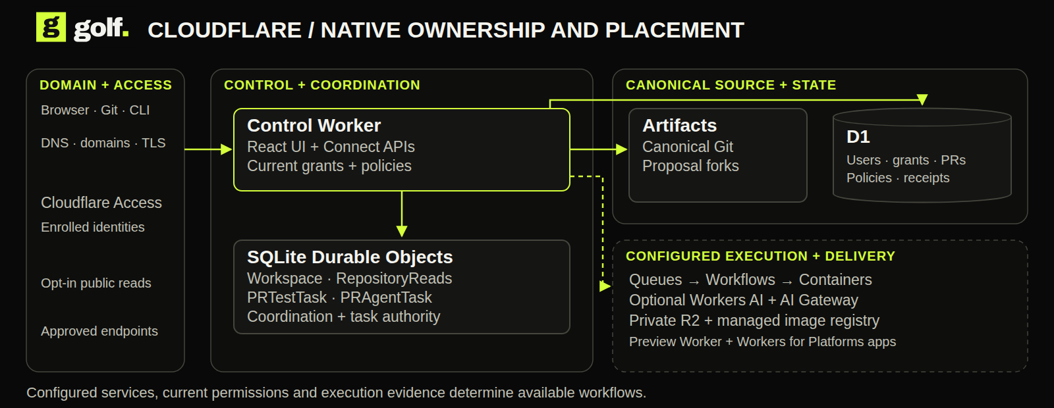
DEPLOYMENT / CLOUDFLARE
Cloudflare: where each part lives.
Workers own the application, Artifacts owns Git, and D1 owns collaboration state.
GOLF / DEVELOPER PREVIEW / OCTOBER 2026
8 / 43
Notes:
The native UI is embedded in the control Worker, not the Static Assets router. Marketing/docs are independent static Workers assets. Engineering inspection on October 14 recorded version 44 at 100% traffic; this is dated evidence, not a public hosted demo. All service bindings and consumer evidence are separate. This diagram shows ownership and placement. Optional services require their own configuration.
Reviewed product evidence: 2026-10-14. https://docs.gitgolf.app/docs/status/

Slide 9

CLOUDFLARE / ARCHITECTURE IN CONTEXT
The storage roles have different jobs.
Artifacts keeps Git; D1 keeps domain state; private R2 keeps outputs; the managed registry keeps images.
CONCEPTUAL ILLUSTRATION / EXACT SERVICE ROLES ON ADJACENT SLIDES
GOLF / DEVELOPER PREVIEW / OCTOBER 2026
9 / 43
Notes:
Conceptual architecture illustration. Exact service responsibilities and current acceptance are explained on the adjacent service slides and service inventory. Artifacts keeps Git; D1 keeps domain state; private R2 keeps outputs; the managed registry keeps images.
Reviewed product evidence: 2026-10-14. https://docs.gitgolf.app/docs/status/

Slide 10
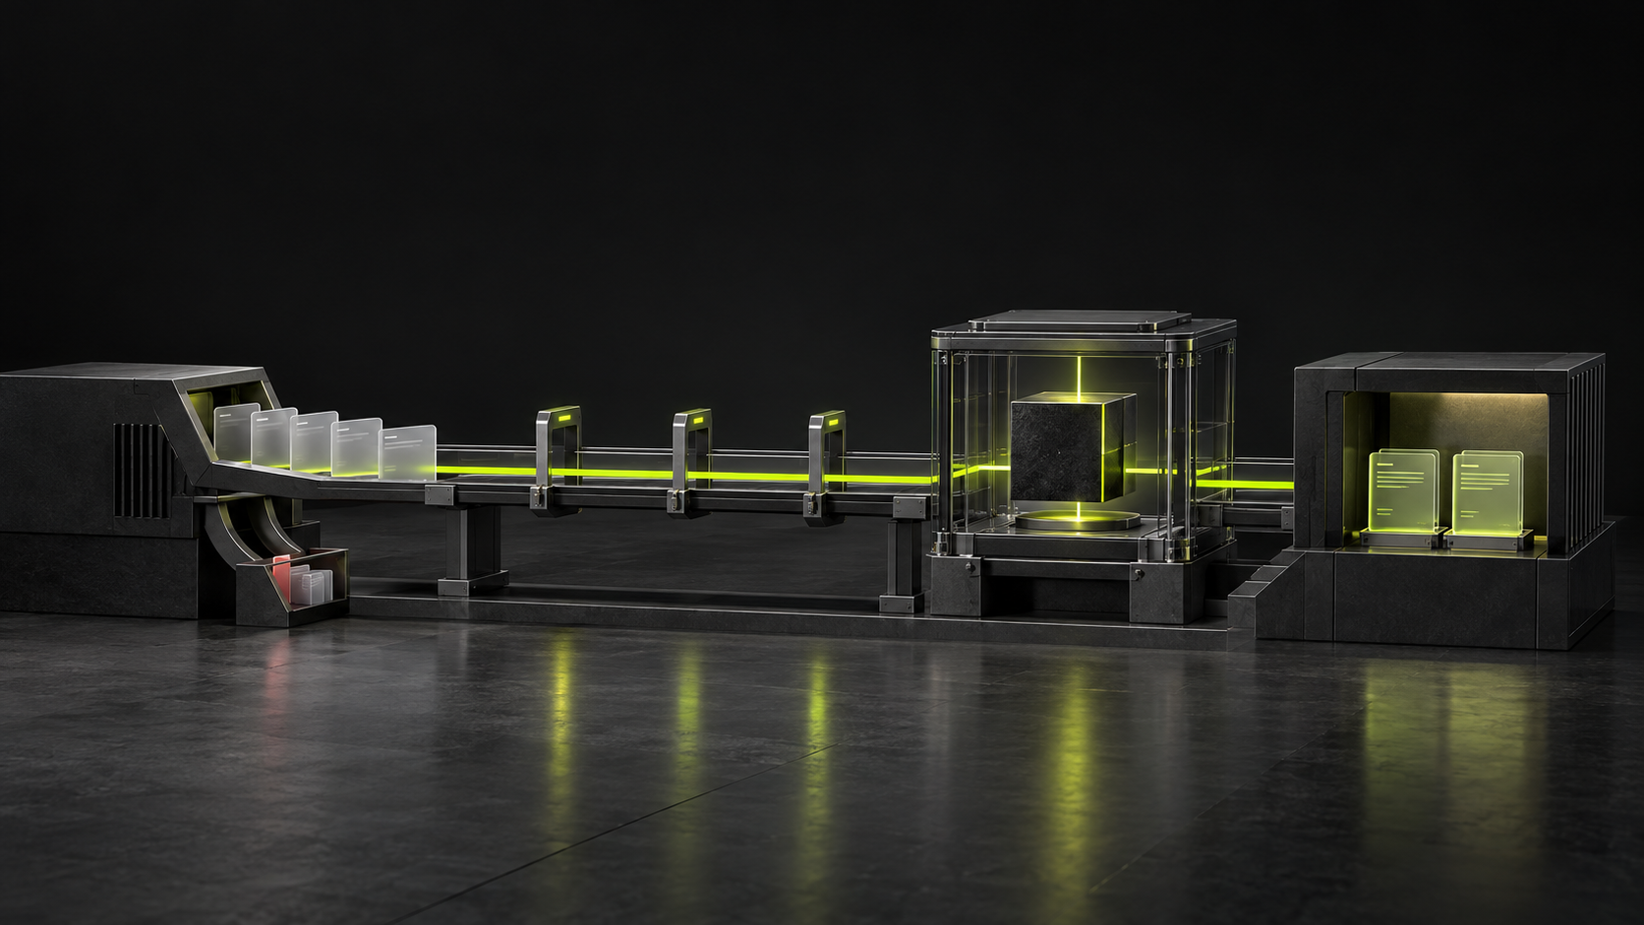
CLOUDFLARE / ARCHITECTURE IN CONTEXT
A durable path to executable evidence.
Authorized exact-source work passes from intake through orchestration and approved compute to private reports.
CONCEPTUAL ILLUSTRATION / EXACT SERVICE ROLES ON ADJACENT SLIDES
GOLF / DEVELOPER PREVIEW / OCTOBER 2026
10 / 43
Notes:
Conceptual architecture illustration. Exact service responsibilities and current acceptance are explained on the adjacent service slides and service inventory. Authorized exact-source work passes from intake through orchestration and approved compute to private reports.
Reviewed product evidence: 2026-10-14. https://docs.gitgolf.app/docs/status/

Slide 11

CLOUDFLARE / ARCHITECTURE IN CONTEXT
Advice and proposals are separate paths.
Clef sees metadata. Executable proposals work on an independent fork and return tests and a patch for human review.
CONCEPTUAL ILLUSTRATION / EXACT SERVICE ROLES ON ADJACENT SLIDES
GOLF / DEVELOPER PREVIEW / OCTOBER 2026
11 / 43
Notes:
Conceptual architecture illustration. Exact service responsibilities and current acceptance are explained on the adjacent service slides and service inventory. Clef sees metadata. Executable proposals work on an independent fork and return tests and a patch for human review.
Reviewed product evidence: 2026-10-14. https://docs.gitgolf.app/docs/status/

Slide 12
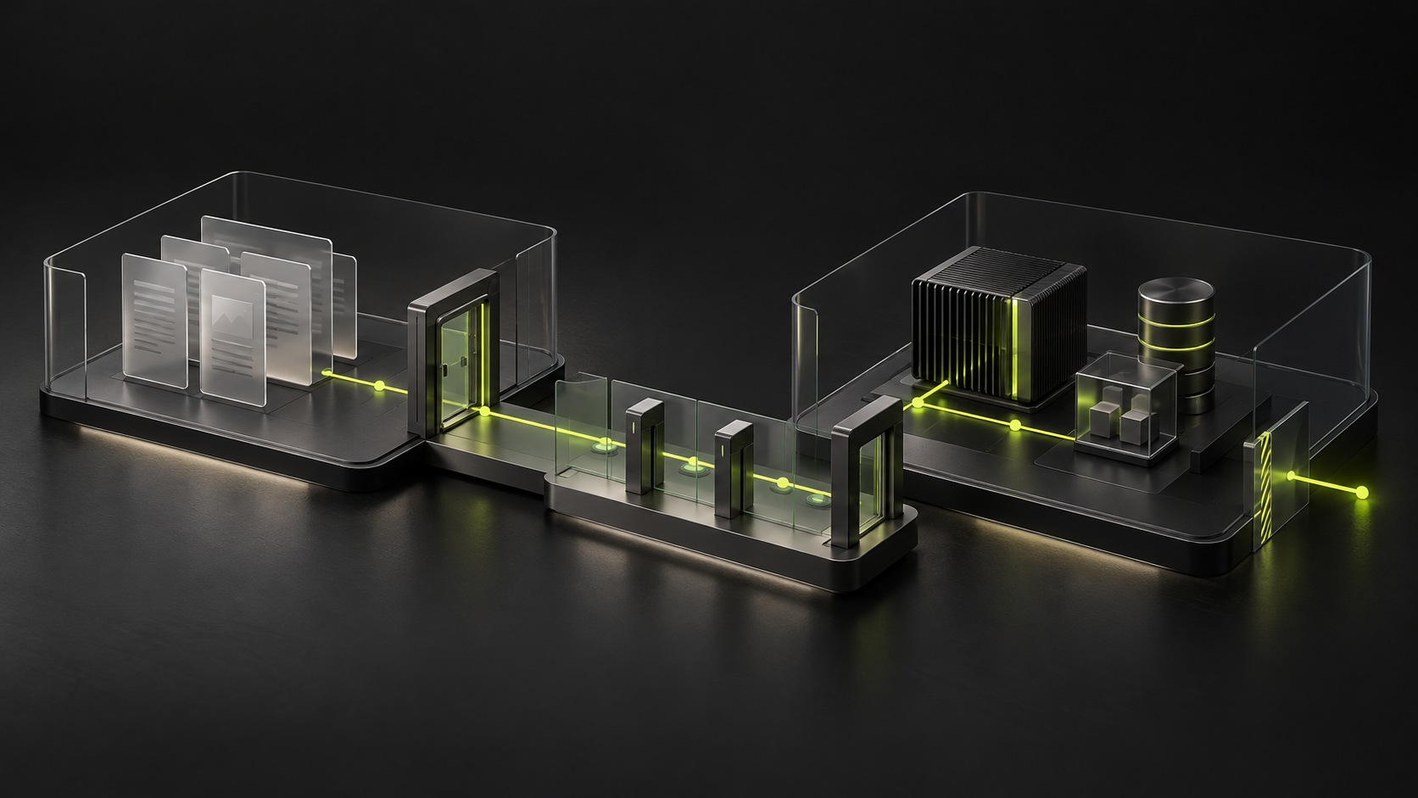
CLOUDFLARE / ARCHITECTURE IN CONTEXT
A running preview has its own boundary.
Static bundles and Worker applications stay protected, isolated and subject to current reader/lease checks.
CONCEPTUAL ILLUSTRATION / EXACT SERVICE ROLES ON ADJACENT SLIDES
GOLF / DEVELOPER PREVIEW / OCTOBER 2026
12 / 43
Notes:
Conceptual architecture illustration. Exact service responsibilities and current acceptance are explained on the adjacent service slides and service inventory. Static bundles and Worker applications stay protected, isolated and subject to current reader/lease checks.
Reviewed product evidence: 2026-10-14. https://docs.gitgolf.app/docs/status/

Slide 13

CLOUDFLARE / SERVICE 01 OF 26
Workers
The product entrypoint
PURPOSE IN GOLF
Serves the shared Golf UI, native APIs, Git brokerage and trusted service entrypoints at custom domains. UI files are embedded in the control Worker.
How the workflow uses it
Current operating boundary
A browser, Git client or Golf CLI reaches the control Worker. Generated Connect handlers and broker entrypoints enforce the same current Golf authority.
Full native forge parity, fleet scale and SaaS onboarding remain open.
01
Browser or CLI
→
02
Worker API
→
03
Current Golf permissions
GOLF / DEVELOPER PREVIEW / OCTOBER 2026
13 / 43
Notes:
Source: cloudflare/forge/prepare.mjs:36
Serves the shared Golf UI, native APIs, Git brokerage and trusted service entrypoints at custom domains. UI files are embedded in the control Worker.
A browser, Git client or Golf CLI reaches the control Worker. Generated Connect handlers and broker entrypoints enforce the same current Golf authority.
Full native forge parity, fleet scale and SaaS onboarding remain open.
Reviewed product evidence: 2026-10-14. https://docs.gitgolf.app/docs/status/

Slide 14
CLOUDFLARE / SERVICE 02 OF 26
Artifacts
Canonical source and proposal isolation
PURPOSE IN GOLF
Stores canonical Git objects/refs and independent agent forks; supports clone/push, source/history/diffs and first-slice standard PR merge.
How the workflow uses it
Current operating boundary
A private Git push/clone goes through Golf admission and short-lived brokered provider access. An agent receives a separate fork; source/history/diffs stay bound to exact objects.
Merge requires same repository and base ancestor of head; no tree merge, squash, protected merge or native repository deletion.
01
Authorized Git request
→
02
Artifacts objects and refs
→
03
Source and independent forks
GOLF / DEVELOPER PREVIEW / OCTOBER 2026
14 / 43
Notes:
Source: cloudflare/forge/src/pull-merge.mjs:112
Stores canonical Git objects/refs and independent agent forks; supports clone/push, source/history/diffs and first-slice standard PR merge.
A private Git push/clone goes through Golf admission and short-lived brokered provider access. An agent receives a separate fork; source/history/diffs stay bound to exact objects.
Merge requires same repository and base ancestor of head; no tree merge, squash, protected merge or native repository deletion.
Reviewed product evidence: 2026-10-14. https://docs.gitgolf.app/docs/status/

Slide 15
CLOUDFLARE / SERVICE 03 OF 26
D1
Collaboration with current permission
PURPOSE IN GOLF
Stores identities, grants, collaboration, operation journals, evidence intake, environments, email outbox and encrypted execution values; separate D1 databases back Worker previews.
How the workflow uses it
Current operating boundary
An issue, PR, review, environment policy or execution intent becomes a versioned domain record. Users/grants, outboxes and readback receipts remain Golf-owned SQL state.
Recovery, broader authorization matrices and complete repository parity remain open.
01
Authorized mutation
→
02
D1 collaboration records
→
03
Scoped readback
GOLF / DEVELOPER PREVIEW / OCTOBER 2026
15 / 43
Notes:
Source: cloudflare/forge/prepare.mjs:46
Stores identities, grants, collaboration, operation journals, evidence intake, environments, email outbox and encrypted execution values; separate D1 databases back Worker previews.
An issue, PR, review, environment policy or execution intent becomes a versioned domain record. Users/grants, outboxes and readback receipts remain Golf-owned SQL state.
Recovery, broader authorization matrices and complete repository parity remain open.
Reviewed product evidence: 2026-10-14. https://docs.gitgolf.app/docs/status/

Slide 16
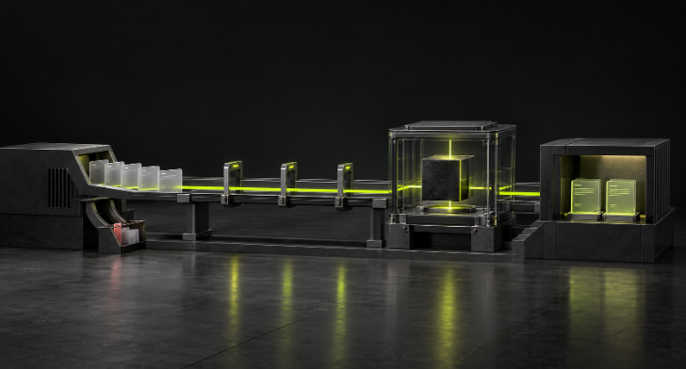
CLOUDFLARE / SERVICE 04 OF 26
Durable Objects
Different objects, different responsibilities
PURPOSE IN GOLF
SQLite workspace authority serializes writes/revocations, admits bounded concurrent reads and coordinates tasks; read shards scale immutable-source reads; alarms run maintenance when Cron stops arriving.
How the workflow uses it
Current operating boundary
Workspace coordinates authority/journals and maintenance. RepositoryReads serves bounded reads; PRTestTask and PRAgentTask own the approved test/proposal compute lifecycle.
Bounded single-installation qualification, not global scale or provider availability.
01
Workspace request
→
02
Object coordination
→
03
Read or task result
GOLF / DEVELOPER PREVIEW / OCTOBER 2026
16 / 43
Notes:
Source: cloudflare/forge/src/worker.mjs:70
SQLite workspace authority serializes writes/revocations, admits bounded concurrent reads and coordinates tasks; read shards scale immutable-source reads; alarms run maintenance when Cron stops arriving.
Workspace coordinates authority/journals and maintenance. RepositoryReads serves bounded reads; PRTestTask and PRAgentTask own the approved test/proposal compute lifecycle.
Bounded single-installation qualification, not global scale or provider availability.
Reviewed product evidence: 2026-10-14. https://docs.gitgolf.app/docs/status/

Slide 17
CLOUDFLARE / SERVICE 05 OF 26
Containers
Run the approved profile
PURPOSE IN GOLF
Runs exact-source approved CI and OpenCode proposals in DO-managed Linux containers with outbound interception and verified destruction.
How the workflow uses it
Current operating boundary
Capture exact source and execute one approved Actions workflow or Python module in the reviewed image. Keep terminal status, denied requests and private output; do not infer general workflow compatibility.
One approved Actions path or Python module; Internet denied; arbitrary upstream workflows and hostile-repo isolation not qualified.
01
Approved source and image
→
02
Isolated container
→
03
Private output receipt
GOLF / DEVELOPER PREVIEW / OCTOBER 2026
17 / 43
Notes:
Source: cloudflare/forge/src/test-worker.mjs:26
Runs exact-source approved CI and OpenCode proposals in DO-managed Linux containers with outbound interception and verified destruction.
Capture exact source and execute one approved Actions workflow or Python module in the reviewed image. Keep terminal status, denied requests and private output; do not infer general workflow compatibility.
One approved Actions path or Python module; Internet denied; arbitrary upstream workflows and hostile-repo isolation not qualified.
Reviewed product evidence: 2026-10-14. https://docs.gitgolf.app/docs/status/

Slide 18
CLOUDFLARE / SERVICE 06 OF 26
Sandbox SDK files
Stage files inside Containers
PURPOSE IN GOLF
Uses @cloudflare/sandbox Files and SandboxFileError to access container files alongside raw ctx.container execution.
How the workflow uses it
Current operating boundary
The harness uses Sandbox SDK helpers to stage and read files inside raw Containers.
Golf uses raw ctx.container execution. It does not instantiate getSandbox or a Sandbox class.
01
Selected files
→
02
Sandbox file helpers
→
03
Container filesystem
GOLF / DEVELOPER PREVIEW / OCTOBER 2026
18 / 43
Notes:
Source: cloudflare/agents/src/worker.mjs:2
Uses @cloudflare/sandbox Files and SandboxFileError to access container files alongside raw ctx.container execution.
The harness uses Sandbox SDK helpers to stage and read files inside raw Containers.
Golf uses raw ctx.container execution. It does not instantiate getSandbox or a Sandbox class.
Reviewed product evidence: 2026-10-14. https://docs.gitgolf.app/docs/status/

Slide 19
CLOUDFLARE / SERVICE 07 OF 26
Managed image registry
Bind an image to the job
PURPOSE IN GOLF
registry.cloudflare.com holds pinned runner images and digest-verified per-job OCI artifacts; trusted Worker brokers short-lived account registry credentials.
How the workflow uses it
Current operating boundary
The approved execution image is published to registry.cloudflare.com. Authorized CI publication and image inventory retain exact digests and repository/job receipts; provider authority stays inside the broker.
Golf brokers provider authority and preserves repository/job approval. Broader image scanning, trust and retention policy remain separate acceptance.
01
Approved image build
→
02
Brokered publication
→
03
Digest-bound receipt
GOLF / DEVELOPER PREVIEW / OCTOBER 2026
19 / 43
Notes:
Source: cloudflare/forge/src/managed-registry.mjs:4
registry.cloudflare.com holds pinned runner images and digest-verified per-job OCI artifacts; trusted Worker brokers short-lived account registry credentials.
The approved execution image is published to registry.cloudflare.com. Authorized CI publication and image inventory retain exact digests and repository/job receipts; provider authority stays inside the broker.
Golf brokers provider authority and preserves repository/job approval. Broader image scanning, trust and retention policy remain separate acceptance.
Reviewed product evidence: 2026-10-14. https://docs.gitgolf.app/docs/status/

Slide 20
CLOUDFLARE / SERVICE 08 OF 26
R2
Private objects with source identity
PURPOSE IN GOLF
Private immutable reports, context/results, read indexes, static previews, screenshots, per-preview app files, release assets and discussion attachments.
How the workflow uses it
Current operating boundary
Reports, context, patches and preview bundles are retrieved only with current reader authority. Bounded release assets and discussion uploads retain original receipts and verified download digests.
Release and attachment slice locally verified; release max 25 assets x 256 KiB, discussion max 100 files x 256 KiB; no attachment replacement/deletion.
01
Checked private output
→
02
R2 storage
→
03
Reader-authorized delivery
GOLF / DEVELOPER PREVIEW / OCTOBER 2026
20 / 43
Notes:
Source: cloudflare/forge/src/releases.mjs:12
Private immutable reports, context/results, read indexes, static previews, screenshots, per-preview app files, release assets and discussion attachments.
Reports, context, patches and preview bundles are retrieved only with current reader authority. Bounded release assets and discussion uploads retain original receipts and verified download digests.
Release and attachment slice locally verified; release max 25 assets x 256 KiB, discussion max 100 files x 256 KiB; no attachment replacement/deletion.
Reviewed product evidence: 2026-10-14. https://docs.gitgolf.app/docs/status/

Slide 21
CLOUDFLARE / SERVICE 09 OF 26
Queues
Make admission durable
PURPOSE IN GOLF
Buffers evidence IDs into Workflows with durable D1 outbox, bounded retries and reauthorization.
How the workflow uses it
Current operating boundary
The evidence queue buffers source-bound work before the Workflow consumer starts it. Stable identity and bounded handling preserve the original request across delivery retries.
Email/webhook transport currently uses D1 outboxes and maintenance, not Queues.
01
Admitted job intent
→
02
Queue and durable outbox
→
03
Workflow consumer
GOLF / DEVELOPER PREVIEW / OCTOBER 2026
21 / 43
Notes:
Source: cloudflare/forge/prepare.mjs:64
Buffers evidence IDs into Workflows with durable D1 outbox, bounded retries and reauthorization.
The evidence queue buffers source-bound work before the Workflow consumer starts it. Stable identity and bounded handling preserve the original request across delivery retries.
Email/webhook transport currently uses D1 outboxes and maintenance, not Queues.
Reviewed product evidence: 2026-10-14. https://docs.gitgolf.app/docs/status/

Slide 22
CLOUDFLARE / SERVICE 10 OF 26
Queues dead-letter queue
Retain exhausted evidence delivery
PURPOSE IN GOLF
Optional separate queue retains failed evidence deliveries and exposes failure retention.
How the workflow uses it
Current operating boundary
An optional separate queue/consumer records delivery that exceeded its normal attempts. Redrive is an operator decision with fresh authority checks; it cannot fabricate passing evidence.
Provisioning implemented on Alchemy; real dead-lettered delivery not exercised on retained installation.
01
Exhausted attempts
→
02
Dead-letter queue
→
03
Operator inspection or redrive
GOLF / DEVELOPER PREVIEW / OCTOBER 2026
22 / 43
Notes:
Source: deploy/alchemy/alchemy.run.ts:29
Optional separate queue retains failed evidence deliveries and exposes failure retention.
An optional separate queue/consumer records delivery that exceeded its normal attempts. Redrive is an operator decision with fresh authority checks; it cannot fabricate passing evidence.
Provisioning implemented on Alchemy; real dead-lettered delivery not exercised on retained installation.
Reviewed product evidence: 2026-10-14. https://docs.gitgolf.app/docs/status/

Slide 23
CLOUDFLARE / SERVICE 11 OF 26
Workflows
Keep stages and outcomes together
PURPOSE IN GOLF
Coordinates authorization, exact-source tests, agent proposals, report publication, previews and cleanup through durable steps.
How the workflow uses it
Current operating boundary
Durable stages reserve authority, start approved compute, retain reports and manage bounded delivery. A provider timeout remains an observed failure/uncertainty, never an assumed success.
Bounded concurrency/retention/steps; Workflows coordinate effects but do not grant authority or approve merges.
01
Admitted job
→
02
Durable execution stages
→
03
Retained terminal outcome
GOLF / DEVELOPER PREVIEW / OCTOBER 2026
23 / 43
Notes:
Source: cloudflare/forge/prepare.mjs:65
Coordinates authorization, exact-source tests, agent proposals, report publication, previews and cleanup through durable steps.
Durable stages reserve authority, start approved compute, retain reports and manage bounded delivery. A provider timeout remains an observed failure/uncertainty, never an assumed success.
Bounded concurrency/retention/steps; Workflows coordinate effects but do not grant authority or approve merges.
Reviewed product evidence: 2026-10-14. https://docs.gitgolf.app/docs/status/

Slide 24
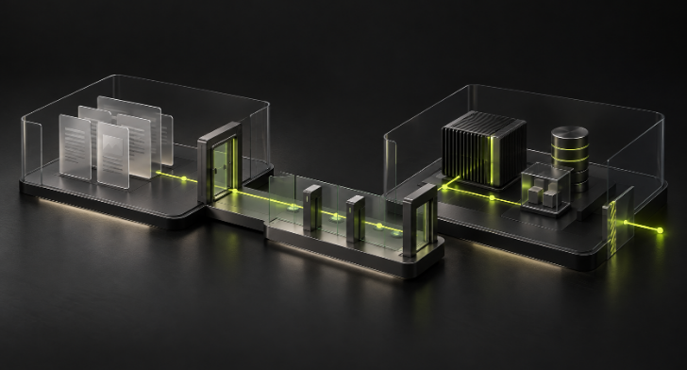
CLOUDFLARE / SERVICE 12 OF 26
Workers for Platforms
An app preview with its own resources
PURPOSE IN GOLF
Dispatches isolated PR Worker applications behind the preview gateway, with separate private D1/R2, child hostnames and an outbound-denial Worker.
How the workflow uses it
Current operating boundary
Dispatch an approved prebundled Worker module with per-preview D1, R2 and signing material. A dedicated Outbound Worker enforces the configured application egress policy.
Only approved prebundled module/schema; arbitrary builds/bindings, app cookies/WebSockets, production promotion and multi-tenant scale remain open.
01
Approved Worker bundle
→
02
Dispatch namespace
→
03
Isolated preview resources
GOLF / DEVELOPER PREVIEW / OCTOBER 2026
24 / 43
Notes:
Source: cloudflare/forge/prepare.mjs:149
Dispatches isolated PR Worker applications behind the preview gateway, with separate private D1/R2, child hostnames and an outbound-denial Worker.
Dispatch an approved prebundled Worker module with per-preview D1, R2 and signing material. A dedicated Outbound Worker enforces the configured application egress policy.
Only approved prebundled module/schema; arbitrary builds/bindings, app cookies/WebSockets, production promotion and multi-tenant scale remain open.
Reviewed product evidence: 2026-10-14. https://docs.gitgolf.app/docs/status/

Slide 25
CLOUDFLARE / SERVICE 13 OF 26
Access / Zero Trust
Identity plus a Golf grant
PURPOSE IN GOLF
OTP login and approved-email policies gate control/preview domains; service tokens protect machine access; Golf rechecks D1 repository grants and short-lived single-use preview grants.
How the workflow uses it
Current operating boundary
Separate human OTP and machine Service Auth policies protect the control/preview entrypoints. Golf maps verified identity to an already enrolled active account, then checks repository permission.
Access admission does not itself grant repository permission; native account lifecycle and broader identity onboarding remain open.
01
OTP or service authentication
→
02
Cloudflare Access
→
03
Current Golf repository grant
GOLF / DEVELOPER PREVIEW / OCTOBER 2026
25 / 43
Notes:
Source: deploy/alchemy/alchemy.run.ts:45
OTP login and approved-email policies gate control/preview domains; service tokens protect machine access; Golf rechecks D1 repository grants and short-lived single-use preview grants.
Separate human OTP and machine Service Auth policies protect the control/preview entrypoints. Golf maps verified identity to an already enrolled active account, then checks repository permission.
Access admission does not itself grant repository permission; native account lifecycle and broader identity onboarding remain open.
Reviewed product evidence: 2026-10-14. https://docs.gitgolf.app/docs/status/

Slide 26
CLOUDFLARE / SERVICE 14 OF 26
DNS, custom domains and TLS
Protect the actual hostnames
PURPOSE IN GOLF
Provides branded control/preview URLs and per-application child hostnames; Email onboarding provisions DKIM/SPF/return-path DNS.
How the workflow uses it
Current operating boundary
Own-zone control and preview domains receive TLS and approved routing. Email sender onboarding adds DNS records. Alternate endpoints must not bypass the Access and Golf reader boundaries.
Selected approved zone/hostnames only; customer vanity-domain lifecycle is separate planned Cloudflare for SaaS work.
01
Owned hostname
→
02
DNS, routes and TLS
→
03
Control, preview or email entry
GOLF / DEVELOPER PREVIEW / OCTOBER 2026
26 / 43
Notes:
Source: deploy/alchemy/alchemy.run.ts:131
Provides branded control/preview URLs and per-application child hostnames; Email onboarding provisions DKIM/SPF/return-path DNS.
Own-zone control and preview domains receive TLS and approved routing. Email sender onboarding adds DNS records. Alternate endpoints must not bypass the Access and Golf reader boundaries.
Selected approved zone/hostnames only; customer vanity-domain lifecycle is separate planned Cloudflare for SaaS work.
Reviewed product evidence: 2026-10-14. https://docs.gitgolf.app/docs/status/

Slide 27
CLOUDFLARE / SERVICE 15 OF 26
Secrets Store
Trusted authority, scoped value release
PURPOSE IN GOLF
Keeps management/registry/analytics credentials, app signing key, webhook encryption key and execution-value AES-GCM key in trusted bindings.
How the workflow uses it
Current operating boundary
Separate secrets hold provisioner/registry/analytics authority, signing and encryption keys. Repository values are ciphertext in D1 and reach only an exact-approved native PR workflow.
Secret rotation procedure and approved external-egress broker remain open; job log masking only detects exact secret text.
01
Encrypted configuration
→
02
Trusted Worker and key
→
03
Approved provider operation
GOLF / DEVELOPER PREVIEW / OCTOBER 2026
27 / 43
Notes:
Source: deploy/alchemy/alchemy.run.ts:82
Keeps management/registry/analytics credentials, app signing key, webhook encryption key and execution-value AES-GCM key in trusted bindings.
Separate secrets hold provisioner/registry/analytics authority, signing and encryption keys. Repository values are ciphertext in D1 and reach only an exact-approved native PR workflow.
Secret rotation procedure and approved external-egress broker remain open; job log masking only detects exact secret text.
Reviewed product evidence: 2026-10-14. https://docs.gitgolf.app/docs/status/

Slide 28

CLOUDFLARE / SERVICE 16 OF 26
Workers AI
Two inference jobs
PURPOSE IN GOLF
Runs optional metadata review advice on @cf/cloudflare/clef and coding proposals on @cf/zai-org/glm-5.3-flash through trusted brokers.
How the workflow uses it
Current operating boundary
Clef supplies metadata-only advisory PR evidence. GLM 5.3 Flash powers the maintained proposal harness on an independent fork; approved tests and human review remain separate from inference.
Advice is metadata-only; proposals change one approved file and are tested in an independent Artifacts fork; per-use-case model selection remains planned.
01
Approved context
→
02
Workers AI inference
→
03
Advice or independent proposal
GOLF / DEVELOPER PREVIEW / OCTOBER 2026
28 / 43
Notes:
Source: docs/NATIVE_ADMIN_AND_AI_ROADMAP.md:83
Runs optional metadata review advice on @cf/cloudflare/clef and coding proposals on @cf/zai-org/glm-5.3-flash through trusted brokers.
Clef supplies metadata-only advisory PR evidence. GLM 5.3 Flash powers the maintained proposal harness on an independent fork; approved tests and human review remain separate from inference.
Advice is metadata-only; proposals change one approved file and are tested in an independent Artifacts fork; per-use-case model selection remains planned.
Reviewed product evidence: 2026-10-14. https://docs.gitgolf.app/docs/status/

Slide 29
CLOUDFLARE / SERVICE 17 OF 26
AI Gateway
A policy on inference
PURPOSE IN GOLF
Private authenticated inference gateway disables prompt/response logs and cache, caps 60 requests/minute and configures 500 cents/day.
How the workflow uses it
Current operating boundary
Route authenticated Workers AI calls through a private gateway, with prompt/response logging and cache disabled. The retained configuration sets 60 requests/minute and a $5/day limit.
Rate/spend-limit enforcement not exercised; admin gateway usage UI remains planned; AI remains opt-in.
01
Authenticated AI request
→
02
Gateway policy and tracing
→
03
Workers AI model
GOLF / DEVELOPER PREVIEW / OCTOBER 2026
29 / 43
Notes:
Source: deploy/alchemy/alchemy.run.ts:31
Private authenticated inference gateway disables prompt/response logs and cache, caps 60 requests/minute and configures 500 cents/day.
Route authenticated Workers AI calls through a private gateway, with prompt/response logging and cache disabled. The retained configuration sets 60 requests/minute and a $5/day limit.
Rate/spend-limit enforcement not exercised; admin gateway usage UI remains planned; AI remains opt-in.
Reviewed product evidence: 2026-10-14. https://docs.gitgolf.app/docs/status/

Slide 30
CLOUDFLARE / SERVICE 18 OF 26
Browser Run
Optional static preview snapshots
PURPOSE IN GOLF
Optional one-dispatch static-preview PNG capture retained privately with digest checks and current-reader authorization.
How the workflow uses it
Current operating boundary
An explicitly authorized snapshot can capture script-free static HTML with external requests denied. A historical hosted proof produced a real PNG; retained captures were not completed at this review.
Enabled in the reviewed engineering deployment, with no completed retained captures at this review. Historical hosted proof covers script-free static HTML only; full interactive QA remains open.
01
Approved script-free HTML
→
02
Browser Run capture
→
03
Private R2 screenshot
GOLF / DEVELOPER PREVIEW / OCTOBER 2026
30 / 43
Notes:
Source: cloudflare/forge/src/delivery.mjs:233
Optional one-dispatch static-preview PNG capture retained privately with digest checks and current-reader authorization.
An explicitly authorized snapshot can capture script-free static HTML with external requests denied. A historical hosted proof produced a real PNG; retained captures were not completed at this review.
Enabled in the reviewed engineering deployment, with no completed retained captures at this review. Historical hosted proof covers script-free static HTML only; full interactive QA remains open.
Reviewed product evidence: 2026-10-14. https://docs.gitgolf.app/docs/status/

Slide 31
CLOUDFLARE / SERVICE 19 OF 26
Analytics Engine
Optional evidence metrics
PURPOSE IN GOLF
Optional sampled evidence-completion counts, report bytes, duration and observed tokens with hashed workspace index and no source/prompts.
How the workflow uses it
Current operating boundary
The deployed dataset binding accepts the implemented source path for bounded evidence metrics. Hosted ingestion/SQL readback still needs acceptance; metrics are not quota or billing authority.
Source, build and binding checks passed. Hosted ingestion and SQL readback are unverified. Metrics do not govern billing or quotas.
01
Execution completion
→
02
Metrics sample
→
03
Analytics Engine dataset
GOLF / DEVELOPER PREVIEW / OCTOBER 2026
31 / 43
Notes:
Source: cloudflare/forge/prepare.mjs:119
Optional sampled evidence-completion counts, report bytes, duration and observed tokens with hashed workspace index and no source/prompts.
The deployed dataset binding accepts the implemented source path for bounded evidence metrics. Hosted ingestion/SQL readback still needs acceptance; metrics are not quota or billing authority.
Source, build and binding checks passed. Hosted ingestion and SQL readback are unverified. Metrics do not govern billing or quotas.
Reviewed product evidence: 2026-10-14. https://docs.gitgolf.app/docs/status/

Slide 32
CLOUDFLARE / SERVICE 20 OF 26
Workers Analytics API
A separate operational read path
PURPOSE IN GOLF
Operations collector reads requests/errors/subrequests from GraphQL with a separate Account Analytics Read credential.
How the workflow uses it
Current operating boundary
Operations requests installed-Worker traffic through a dedicated account Analytics Read token in Secrets Store. The retained feed has failed collection; configured is distinct from collected.
Collection currently fails inside the Worker. The equivalent token/query succeeds externally.
01
Operator observation
→
02
GraphQL analytics query
→
03
Provider response or failure
GOLF / DEVELOPER PREVIEW / OCTOBER 2026
32 / 43
Notes:
Source: cloudflare/forge/src/operations-provider.mjs:22
Operations collector reads requests/errors/subrequests from GraphQL with a separate Account Analytics Read credential.
Operations requests installed-Worker traffic through a dedicated account Analytics Read token in Secrets Store. The retained feed has failed collection; configured is distinct from collected.
Collection currently fails inside the Worker. The equivalent token/query succeeds externally.
Reviewed product evidence: 2026-10-14. https://docs.gitgolf.app/docs/status/

Slide 33
CLOUDFLARE / SERVICE 21 OF 26
Workers Logs / managed observability
Provider observations with explicit policy
PURPOSE IN GOLF
Optional sampled logs help diagnose the native deployment alongside local D1 journals.
How the workflow uses it
Current operating boundary
The retained Worker reports observability enabled and logpush disabled. Invocation/log/query-string/privacy and retention settings remain separately scoped; no complete trace/export consumer is claimed.
Provider observability is enabled on the reviewed engineering deployment; logpush is disabled. Wider tracing/export and retention remain separate acceptance.
01
Worker invocation
→
02
Managed provider logs
→
03
Operator inspection
GOLF / DEVELOPER PREVIEW / OCTOBER 2026
33 / 43
Notes:
Source: cloudflare/forge/src/operations-provider.mjs:14
Optional sampled logs help diagnose the native deployment alongside local D1 journals.
The retained Worker reports observability enabled and logpush disabled. Invocation/log/query-string/privacy and retention settings remain separately scoped; no complete trace/export consumer is claimed.
Provider observability is enabled on the reviewed engineering deployment; logpush is disabled. Wider tracing/export and retention remain separate acceptance.
Reviewed product evidence: 2026-10-14. https://docs.gitgolf.app/docs/status/

Slide 34
CLOUDFLARE / SERVICE 22 OF 26
Cron Triggers
Maintenance with a fallback
PURPOSE IN GOLF
Configured five-minute maintenance for CI intake retry, preview purge, evidence/index reconciliation, webhook/email retries and probes.
How the workflow uses it
Current operating boundary
The declared schedule has delivered no events on the retained account. Workspace keeps a five-minute alarm and runs maintenance after ten minutes without a scheduled report; it stands down when cron resumes.
Retained account receives no scheduled events; workspace DO alarm supplies maintenance fallback and cause is unresolved.
01
Cron tick or object alarm
→
02
Maintenance coordinator
→
03
Cleanup and retry
GOLF / DEVELOPER PREVIEW / OCTOBER 2026
34 / 43
Notes:
Source: docs/IMPLEMENTATION_STATUS.md:159
Configured five-minute maintenance for CI intake retry, preview purge, evidence/index reconciliation, webhook/email retries and probes.
The declared schedule has delivered no events on the retained account. Workspace keeps a five-minute alarm and runs maintenance after ten minutes without a scheduled report; it stands down when cron resumes.
Retained account receives no scheduled events; workspace DO alarm supplies maintenance fallback and cause is unresolved.
Reviewed product evidence: 2026-10-14. https://docs.gitgolf.app/docs/status/

Slide 35
CLOUDFLARE / SERVICE 23 OF 26
Workers rate limiting
Bound anonymous reads approximately
PURPOSE IN GOLF
Optional per-network/location approximate throttling protects credential-less public source and clone reads.
How the workflow uses it
Current operating boundary
Credential-less public source/clone requests use per-network/location rate counts. Signed-in, credentialed and runner calls are excluded. A limiter error allows the request; this is not a global execution quota.
Signed-in, credentialed and runner requests are excluded. Limiter errors allow the request. This is not a security quota.
01
Anonymous read request
→
02
Rate-limit binding
→
03
Read or fail-open policy
GOLF / DEVELOPER PREVIEW / OCTOBER 2026
35 / 43
Notes:
Source: cloudflare/forge/src/rate-limit.mjs:13
Optional per-network/location approximate throttling protects credential-less public source and clone reads.
Credential-less public source/clone requests use per-network/location rate counts. Signed-in, credentialed and runner calls are excluded. A limiter error allows the request; this is not a global execution quota.
Signed-in, credentialed and runner requests are excluded. Limiter errors allow the request. This is not a security quota.
Reviewed product evidence: 2026-10-14. https://docs.gitgolf.app/docs/status/

Slide 36
CLOUDFLARE / SERVICE 24 OF 26
Email Service sending
Notify the enrolled address
PURPOSE IN GOLF
Consent-based own-Access-address repository subscriptions receive category-and-link notifications from D1 outbox with rechecks, bounded retries and daily attempt budget.
How the workflow uses it
Current operating boundary
Consent and repository subscriptions fill a D1 outbox. Send from the onboarded subdomain after current account/address/grant checks; record provider acceptance and bounded retry observations.
Retained installation provider acceptance verified; inbox receipt unobserved; bounces/complaints/replies/unsubscribe links remain open.
01
Consent and current grant
→
02
D1 notification outbox
→
03
Email provider acceptance
GOLF / DEVELOPER PREVIEW / OCTOBER 2026
36 / 43
Notes:
Source: docs/IMPLEMENTATION_STATUS.md:36
Consent-based own-Access-address repository subscriptions receive category-and-link notifications from D1 outbox with rechecks, bounded retries and daily attempt budget.
Consent and repository subscriptions fill a D1 outbox. Send from the onboarded subdomain after current account/address/grant checks; record provider acceptance and bounded retry observations.
Retained installation provider acceptance verified; inbox receipt unobserved; bounces/complaints/replies/unsubscribe links remain open.
Reviewed product evidence: 2026-10-14. https://docs.gitgolf.app/docs/status/

Slide 37
CLOUDFLARE / SERVICE 25 OF 26
Signed webhooks
Deliver a committed event observation
PURPOSE IN GOLF
Encrypted repository subscriptions and stable signed deliveries to approved HTTPS receivers; retained Slack test accepted.
How the workflow uses it
Current operating boundary
Encrypted subscriptions choose approved HTTPS origins. Sign a stable event document and retain receipt/attempt status. Native Slack delivery uses the accepted text shape; receivers should deduplicate.
D1 outbox/maintenance provides bounded retries, not queue-based email/webhook transport. Receiver/event/retry matrix remains bounded.
01
Repository event
→
02
Signed D1 outbox
→
03
Authorized HTTPS receiver
GOLF / DEVELOPER PREVIEW / OCTOBER 2026
37 / 43
Notes:
Source: cloudflare/forge/src/webhooks.mjs
Encrypted repository subscriptions and stable signed deliveries to approved HTTPS receivers; retained Slack test accepted.
Encrypted subscriptions choose approved HTTPS origins. Sign a stable event document and retain receipt/attempt status. Native Slack delivery uses the accepted text shape; receivers should deduplicate.
D1 outbox/maintenance provides bounded retries, not queue-based email/webhook transport. Receiver/event/retry matrix remains bounded.
Reviewed product evidence: 2026-10-14. https://docs.gitgolf.app/docs/status/

Slide 38
CLOUDFLARE / SERVICE 26 OF 26
Cloudflare CLI
Provision and verify owned resources
PURPOSE IN GOLF
cf supplies scoped provider discovery, setup/deploy and readback qualification; Alchemy optionally provisions equivalent reviewed native resources.
How the workflow uses it
Current operating boundary
Alchemy defines the stack; native cf supplies supported operations and deployment. Additive migration, token renewal, binding/domain readback and ownership-aware teardown keep the installation concrete.
Alchemy beta and cf beta are deployment dependencies only; private state/journals require careful ownership and teardown inspection.
01
Declared deployment recipe
→
02
Scoped Cloudflare CLI
→
03
Resource creation and readback
GOLF / DEVELOPER PREVIEW / OCTOBER 2026
38 / 43
Notes:
Source: deploy/alchemy/README.md:1
cf supplies scoped provider discovery, setup/deploy and readback qualification; Alchemy optionally provisions equivalent reviewed native resources.
Alchemy defines the stack; native cf supplies supported operations and deployment. Additive migration, token renewal, binding/domain readback and ownership-aware teardown keep the installation concrete.
Alchemy beta and cf beta are deployment dependencies only; private state/journals require careful ownership and teardown inspection.
Reviewed product evidence: 2026-10-14. https://docs.gitgolf.app/docs/status/

Slide 39
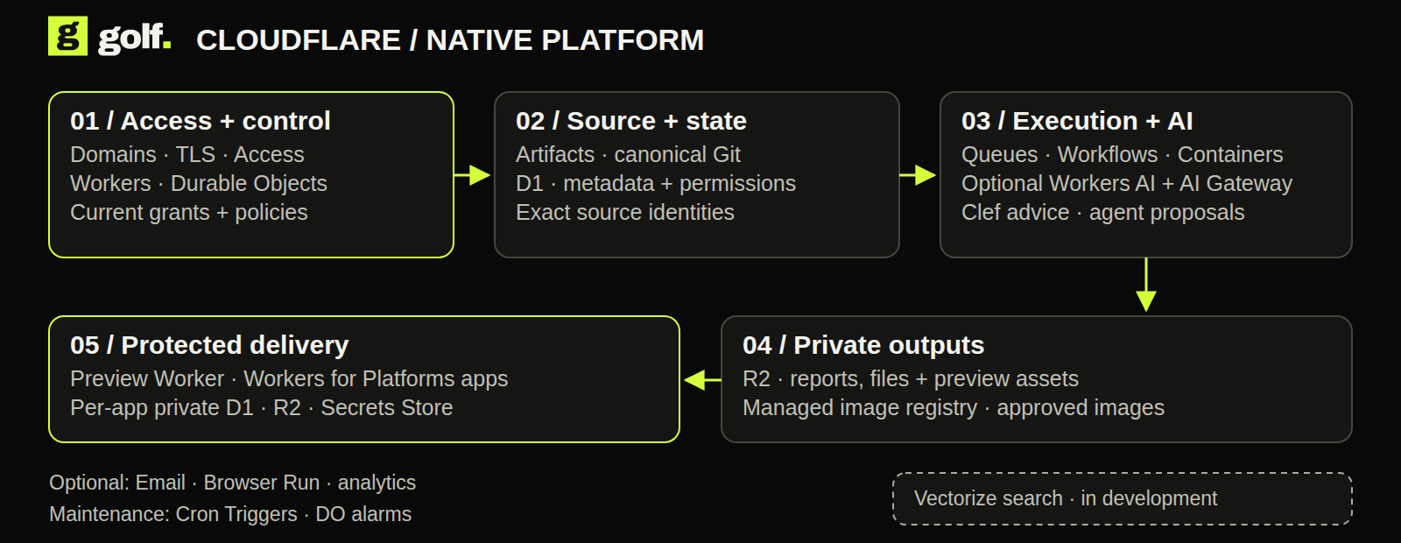
NATIVE ARCHITECTURE
A platform built from managed primitives.
Each service has a specific role. Golf retains current authorization.
GOLF / DEVELOPER PREVIEW / OCTOBER 2026
39 / 43
Notes:
The native UI is embedded in the control Worker, not served by the authenticated Static Assets router. Marketing and docs are independent static Workers deployments. Artifacts is canonical Git on this track; no Forgejo origin is required.
Reviewed product evidence: 2026-10-14. https://docs.gitgolf.app/docs/status/

Slide 40
THE DAILY LOOP
Code. Check. Review. Preview.
Follow one exact change through the workspace.
01
02
01 / Source
02 / Change
Select the repository, branch and exact commit.
Open an issue or same-repository PR and request review.
03
04
03 / Check
04 / Preview
Run an authorized profile and inspect the terminal report.
Publish an allowed protected preview and inspect the result.
GOLF / DEVELOPER PREVIEW / OCTOBER 2026
40 / 43
Notes:
Browser simulations use sample data and do not execute operations. In an owned Cloudflare deployment, private collaboration and execution require Access enrollment and a current repository grant. A passing test is not a publication permission.
Reviewed product evidence: 2026-10-14. https://docs.gitgolf.app/docs/status/

Slide 41
IN DEVELOPMENT / VECTORIZE
Search beyond exact matches.
Semantic code and issue search is being added.
01
02
03
Workers AI embeddings
Vectorize
Current reader access
Create semantic representations from approved source content.
Index and query those representations to find related code and issues.
Filter results by live repository authority and propagate deletion/revocation.
GOLF / DEVELOPER PREVIEW / OCTOBER 2026
41 / 43
Notes:
This is in development per the product owner. No Vectorize binding or accepted semantic-search path was found in the reviewed engineering deployment. AI Search is not implied.
Reviewed product evidence: 2026-10-14. https://docs.gitgolf.app/docs/status/

Slide 42
CURRENT QUALIFICATION
A developer preview with real evidence.
Dated engineering proofs cover selected Git, test, proposal and protected-preview paths. Production readiness still needs testing.
01
02
03
Demonstrated
Incomplete or degraded
Next acceptance
Hosted Git, collaboration, approved tests, Clef advice, scoped proposals, protected previews, email acceptance and secret-to-step delivery.
Cron delivery and analytics collection; Analytics Engine ingest; retained screenshots; broader role/load/cleanup matrices.
Full parity, protected merge, production CD, native/Forgejo recovery, tenant onboarding and scale. Vectorize search is in development.
GOLF / DEVELOPER PREVIEW / OCTOBER 2026
42 / 43
Notes:
Dated engineering proofs cover selected Git, test, proposal and protected-preview paths. Production readiness still needs testing.
Reviewed product evidence: 2026-10-14. https://docs.gitgolf.app/docs/status/

Slide 43
YOUR NEXT MOVE
Try Golf for yourself.
Start with a browser simulation, then install Golf to evaluate real workflows.
01
02
03
Browser simulations
Choose your deployment
Evaluate real work
gitgolf.app/demo: explore local and Cloudflare interfaces with sample data. No backend or live execution.
Docker Compose or Golf’s Helm chart for portable hosting. Use the native Alchemy recipe in your own Cloudflare account.
Enroll a user and grant repository access on your installation. Check an exact commit and inspect its report. docs.gitgolf.app
GOLF / DEVELOPER PREVIEW / OCTOBER 2026
43 / 43
Notes:
All deployment instructions and current capability limits are in the documentation. Private source checkout requires repository access. Product provisioning creates real account resources and costs. Links: https://gitgolf.app/try and https://docs.gitgolf.app/docs/getting-started/.
Reviewed product evidence: 2026-10-14. https://docs.gitgolf.app/docs/status/

