Slide 1

GOLF / GOLF FOR PLATFORM TEAMS
Build deliberately. Operate with context.
Ownership, policy and infrastructure choice.
GOLF / DEVELOPER PREVIEW / OCTOBER 2026
1 / 29
Notes:
Golf developer preview. Evidence and binding review October 14, 2026. This conceptual cover illustration is not a system diagram. Audience: Golf for platform teams.
Reviewed product evidence: 2026-10-14. https://docs.gitgolf.app/docs/status/

Slide 2
THE PRODUCT
From source to software.
Golf connects Git, collaboration, executable evidence, optional proposals and protected previews.
01
02
03
Source
Evidence
Delivery
Repositories, history, issues, PRs and human review.
Approved exact-source tests, reports and proposals.
Protected static and bounded Worker app previews.
GOLF / DEVELOPER PREVIEW / OCTOBER 2026
2 / 29
Notes:
Golf connects Git, collaboration, executable evidence, optional proposals and protected previews.
Reviewed product evidence: 2026-10-14. https://docs.gitgolf.app/docs/status/

Slide 3
PLATFORM EVALUATION
Choose the boundaries you can operate.
Evaluate one bounded workflow in an owned installation.
01
02
03
Placement
Authority
Evidence
Keep the portable core on your infrastructure or adopt the native Cloudflare control plane.
Separate identity, repository grants, execution approval and preview/merge permission.
Test revocation, uncertain outcomes, cleanup and recovery; a running demo is not a production readiness claim.
GOLF / DEVELOPER PREVIEW / OCTOBER 2026
3 / 29
Notes:
Evaluate one bounded workflow in an owned installation.
Reviewed product evidence: 2026-10-14. https://docs.gitgolf.app/docs/status/

Slide 4
DEPLOYMENT / DOCKER
Docker: the portable Golf stack.
Run a complete developer core on your machine or owned Docker infrastructure.
01
02
03
What runs
How to start
What you own
Golf React/Go, Forgejo and independent PostgreSQL databases/roles. Private configuration and persistent volumes survive ordinary restarts.
Initialize private environment files, start Compose, check /readyz, then enroll a mapped Golf account. Optional Docker workers, agents and object storage require their own setup.
Image/version choices, HTTPS beyond loopback, secrets, data volumes and coordinated recovery. No Cloudflare or AI account is needed for core work.
GOLF / DEVELOPER PREVIEW / OCTOBER 2026
4 / 29
Notes:
Full quick start: https://docs.gitgolf.app/docs/installation/ . Current image internal paths retain native directory names; component and provider are Forgejo. Never routinely delete retained volumes.
Reviewed product evidence: 2026-10-14. https://docs.gitgolf.app/docs/status/

Slide 5
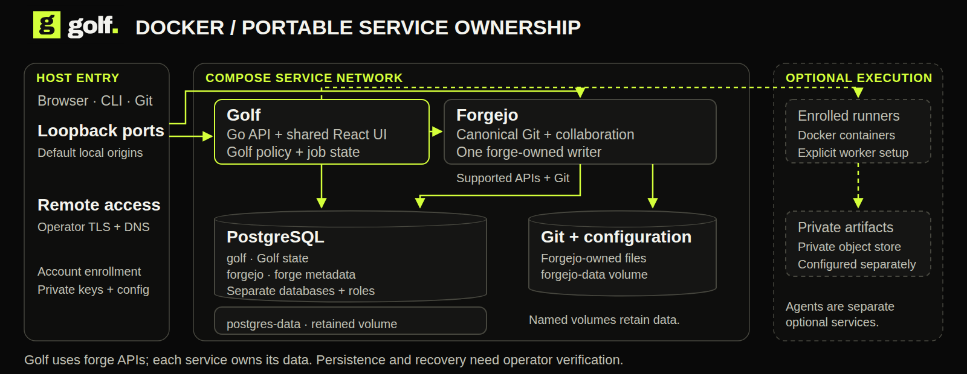
DEPLOYMENT / DOCKER
Docker: what runs, what persists.
The portable core uses Forgejo and PostgreSQL. Execution workers are allocated separately.
GOLF / DEVELOPER PREVIEW / OCTOBER 2026
5 / 29
Notes:
Full quick start: https://docs.gitgolf.app/docs/installation/ . Current image internal paths retain native directory names; component and provider are Forgejo. Never routinely delete retained volumes. This diagram shows ownership and placement. Optional services require their own configuration.
Reviewed product evidence: 2026-10-14. https://docs.gitgolf.app/docs/status/

Slide 6
DEPLOYMENT / KUBERNETES
Kubernetes: deploy Golf deliberately.
Golf’s Helm chart packages the portable core and makes its operating boundaries explicit.
01
02
03
What the chart supplies
How it is hardened
What you supply
Golf replicas, one Forgejo writer, optional PostgreSQL, resources/probes, retained claims, non-root isolation and default-deny policies.
Upgrade identity/endpoint fences, API hostname spread and multi-replica disruption budget, graceful drain, private database CA mounts and explicit DNS/egress peers.
Built image, existing credential/certificate Secrets, enforcing CNI, storage, ingress/TLS/DNS and a tested recovery procedure. Runners and agent services remain separate.
GOLF / DEVELOPER PREVIEW / OCTOBER 2026
6 / 29
Notes:
Complete guide: https://docs.gitgolf.app/docs/kubernetes/ . Chart 0.2.0 passed a fresh one-node k3d runtime proof on 2026-10-14: two API replicas, private Git and immutable source, cross-replica sessions/revocation, restart persistence, enforced network denials, external dependencies, identity refusal and retained claims. Extra API replicas do not make Forgejo/storage/database highly available. Multi-node failover, public ingress/TLS, CA rotation and full recovery remain open.
Reviewed product evidence: 2026-10-14. https://docs.gitgolf.app/docs/status/

Slide 7
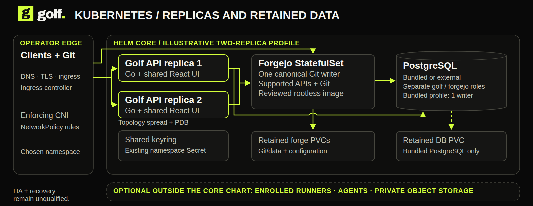
DEPLOYMENT / KUBERNETES
Kubernetes: placement and ownership.
API replicas share one forge writer and retained storage. More replicas alone do not establish HA.
GOLF / DEVELOPER PREVIEW / OCTOBER 2026
7 / 29
Notes:
Complete guide: https://docs.gitgolf.app/docs/kubernetes/ . Chart 0.2.0 passed a fresh one-node k3d runtime proof on 2026-10-14: two API replicas, private Git and immutable source, cross-replica sessions/revocation, restart persistence, enforced network denials, external dependencies, identity refusal and retained claims. Extra API replicas do not make Forgejo/storage/database highly available. Multi-node failover, public ingress/TLS, CA rotation and full recovery remain open. This diagram shows ownership and placement. Optional services require their own configuration.
Reviewed product evidence: 2026-10-14. https://docs.gitgolf.app/docs/status/

Slide 8
DEPLOYMENT / NATIVE CLOUDFLARE
Cloudflare: a native hosted control plane.
Artifacts, D1 and Workers replace origin-backed forge infrastructure on this track.
01
02
03
What runs
How the workflow grows
How to deploy
Shared UI/Connect services in Workers; Artifacts canonical Git; D1 collaboration/policy; SQLite Durable Objects coordinating reads and execution.
Queues, Workflows and Containers produce evidence. Private R2, managed registry and protected Worker apps retain outputs. Optional AI, browser snapshots, email and operations add focused consumers.
Alchemy or the native cf recipe provisions owned resources under the selected account, Access identity, domains, images and permissions. Verify actual schema, grants, readback and cleanup.
GOLF / DEVELOPER PREVIEW / OCTOBER 2026
8 / 29
Notes:
The native UI is embedded in the control Worker, not the Static Assets router. Marketing/docs are independent static Workers assets. Engineering inspection on October 14 recorded version 44 at 100% traffic; this is dated evidence, not a public hosted demo. All service bindings and consumer evidence are separate.
Reviewed product evidence: 2026-10-14. https://docs.gitgolf.app/docs/status/

Slide 9
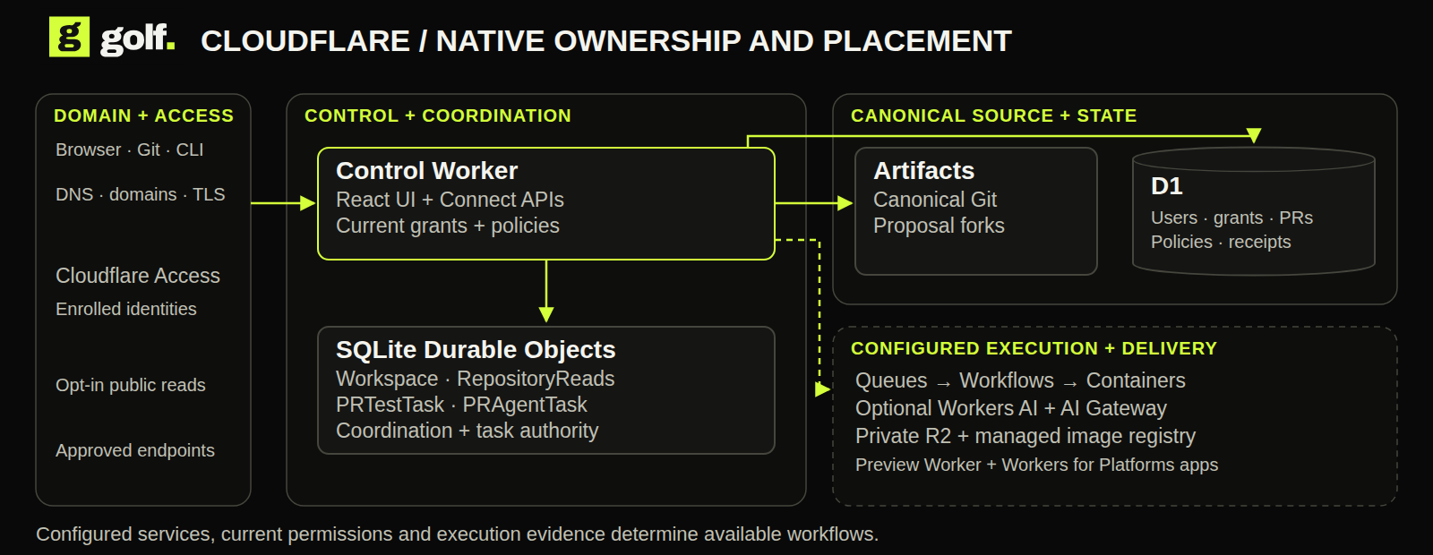
DEPLOYMENT / CLOUDFLARE
Cloudflare: where each part lives.
Workers own the application, Artifacts owns Git, and D1 owns collaboration state.
GOLF / DEVELOPER PREVIEW / OCTOBER 2026
9 / 29
Notes:
The native UI is embedded in the control Worker, not the Static Assets router. Marketing/docs are independent static Workers assets. Engineering inspection on October 14 recorded version 44 at 100% traffic; this is dated evidence, not a public hosted demo. All service bindings and consumer evidence are separate. This diagram shows ownership and placement. Optional services require their own configuration.
Reviewed product evidence: 2026-10-14. https://docs.gitgolf.app/docs/status/

Slide 10
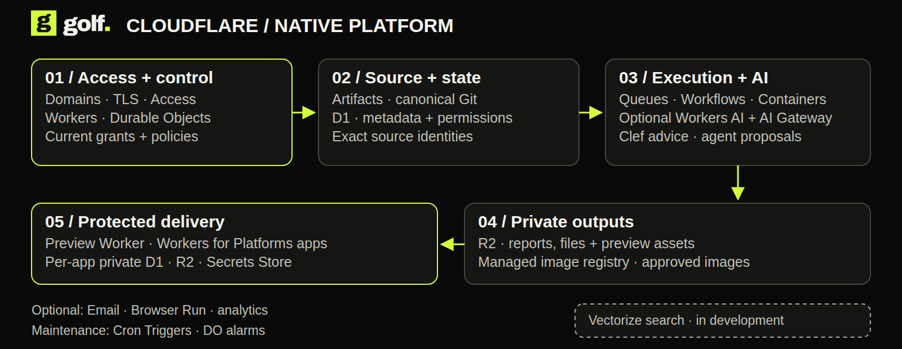
NATIVE ARCHITECTURE
A platform built from managed primitives.
Each service has a specific role. Golf retains current authorization.
GOLF / DEVELOPER PREVIEW / OCTOBER 2026
10 / 29
Notes:
The native UI is embedded in the control Worker, not served by the authenticated Static Assets router. Marketing and docs are independent static Workers deployments. Artifacts is canonical Git on this track; no Forgejo origin is required.
Reviewed product evidence: 2026-10-14. https://docs.gitgolf.app/docs/status/

Slide 11
SOURCE + COLLABORATION
Canonical Git. Explicit authority.
The control plane is native to Cloudflare.
01
02
Workers
Artifacts
Shared React UI, generated Connect APIs, Git brokerage and trusted service entrypoints.
Canonical Git objects and refs, source/history and independent proposal forks.
03
04
D1
Durable Objects
Accounts, repository grants, collaboration, policy, operation receipts and job records.
Workspace and RepositoryReads coordination; PRTestTask and PRAgentTask execution authority.
GOLF / DEVELOPER PREVIEW / OCTOBER 2026
11 / 29
Notes:
The control plane is native to Cloudflare.
Reviewed product evidence: 2026-10-14. https://docs.gitgolf.app/docs/status/

Slide 12
EXECUTABLE EVIDENCE
Durable admission. Bounded compute.
Run a selected exact-source profile and retain what actually happened.
01
02
Queues + dead-letter queue
Workflows
Buffer evidence admission; optional DLQ retains exhausted messages for deliberate recovery.
Retain staged orchestration and outcomes; never grant repository authority.
03
04
Containers
Sandbox SDK file helpers
Approved images execute checks and proposals with bounded source and network access.
File staging inside raw Containers. A separate general Sandbox runtime is not implied.
GOLF / DEVELOPER PREVIEW / OCTOBER 2026
12 / 29
Notes:
DLQ is deployed/configured but a real exhausted delivery is not exercised on retained installation. Native workflow compatibility is bounded to approved profiles; jobs cannot use arbitrary actions or Internet access.
Reviewed product evidence: 2026-10-14. https://docs.gitgolf.app/docs/status/

Slide 13
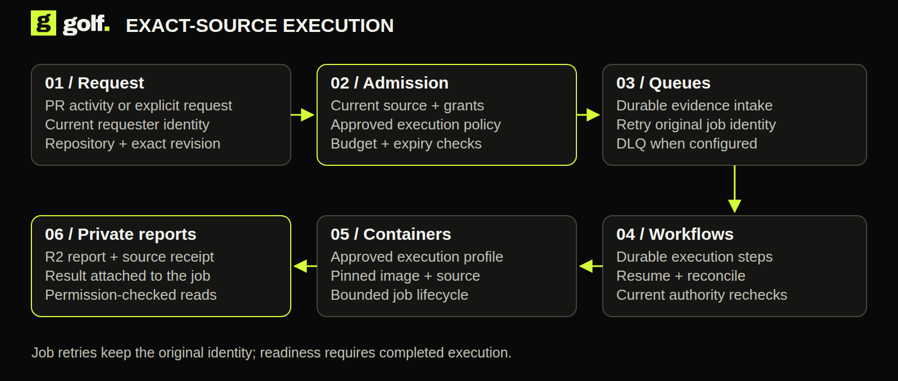
EXECUTABLE EVIDENCE / THE FLOW
Follow one exact-source check.
From authorized admission to retained private evidence.
GOLF / DEVELOPER PREVIEW / OCTOBER 2026
13 / 29
Notes:
DLQ is deployed/configured but a real exhausted delivery is not exercised on retained installation. Native workflow compatibility is bounded to approved profiles; jobs cannot use arbitrary actions or Internet access. See the visual field guide for the editable source.
Reviewed product evidence: 2026-10-14. https://docs.gitgolf.app/docs/status/

Slide 14
STORAGE + DISTRIBUTION
Keep the source. Keep the proof.
Use different storage for different responsibilities.
01
02
Artifacts
Private R2
Git history and proposal forks, with current reader/writer checks.
Reports, agent context, preview bundles, release assets and discussion attachments.
03
04
Managed image registry
Secrets Store
Approved execution images and CI publication on registry.cloudflare.com; Golf retains digest receipts.
Broker authority, signing material and encryption keys; never browser-held provider secrets.
GOLF / DEVELOPER PREVIEW / OCTOBER 2026
14 / 29
Notes:
New release/attachment consumer slices have local evidence and bounded 256 KiB file limits; full hosted acceptance is separate. Managed registry provider tokens are brokered, while Golf enforces repository/job authority. Broader scanning/trust/retention policy remains open.
Reviewed product evidence: 2026-10-14. https://docs.gitgolf.app/docs/status/

Slide 15
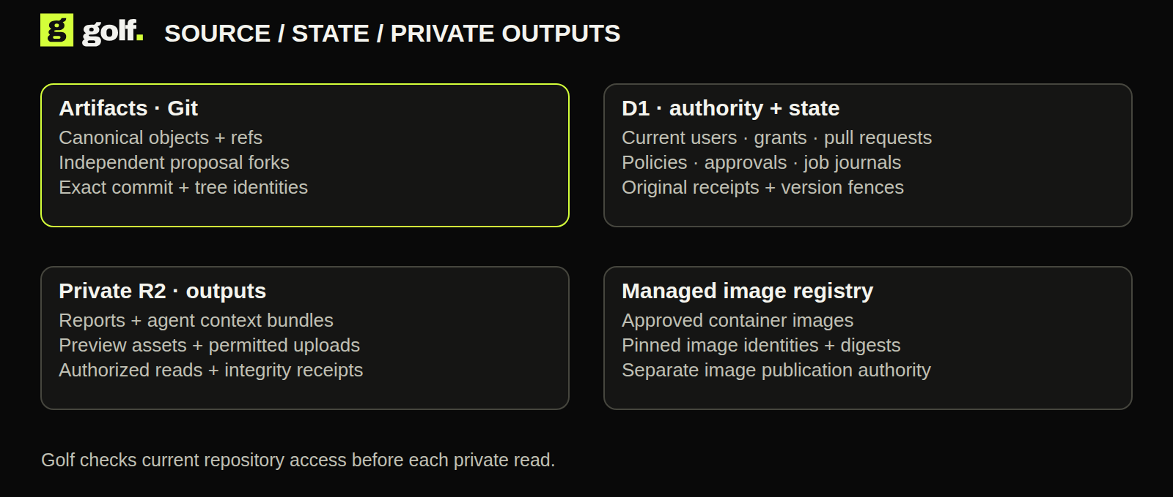
STORAGE + DISTRIBUTION / THE FLOW
Source, state and outputs.
Give each kind of data the right home.
GOLF / DEVELOPER PREVIEW / OCTOBER 2026
15 / 29
Notes:
New release/attachment consumer slices have local evidence and bounded 256 KiB file limits; full hosted acceptance is separate. Managed registry provider tokens are brokered, while Golf enforces repository/job authority. Broader scanning/trust/retention policy remains open. See the visual field guide for the editable source.
Reviewed product evidence: 2026-10-14. https://docs.gitgolf.app/docs/status/

Slide 16
MANAGED IMAGE REGISTRY
Images tied to the job that produced them.
Cloudflare hosts the images. Golf controls the authorized publication path.
01
02
03
Approved execution
CI image publication
Inventory and receipts
Deploy the pinned, approved runner image; exact digest is part of the evidence.
Successful authorized jobs publish under scoped Golf repository/job decisions.
Retain image identities and digest verification without exposing provider credentials.
GOLF / DEVELOPER PREVIEW / OCTOBER 2026
16 / 29
Notes:
The managed provider credential is account-scoped and stays inside the trusted broker. Golf supplies repository authority. Build receipts alone do not establish publication, and general image scanning/trust policy is separate acceptance.
Reviewed product evidence: 2026-10-14. https://docs.gitgolf.app/docs/status/

Slide 17
IDENTITY + DOMAINS + POLICY
Identity is the start of permission.
Access, Golf authority and deployment policy work together.
01
02
Access / Zero Trust
DNS, custom domains + TLS
Separate human OTP and machine service admission; Golf requires an enrolled account and current grants.
Owned-zone control/preview hostnames and email sender records. Protection covers approved endpoints.
03
04
Secrets + environment policy
Workers rate limiting
Encrypt repository values; approve exact-commit PR workflow release. Restrict preview branch, lifetime and concurrency.
Approximate anonymous read/clone throttling by network and location. Errors fail open; not a global quota.
GOLF / DEVELOPER PREVIEW / OCTOBER 2026
17 / 29
Notes:
Account or Access administration does not override repository authority. Exact-text masking does not detect transformed secrets. Changing preview policy does not yet revoke all existing nonconforming previews.
Reviewed product evidence: 2026-10-14. https://docs.gitgolf.app/docs/status/

Slide 18
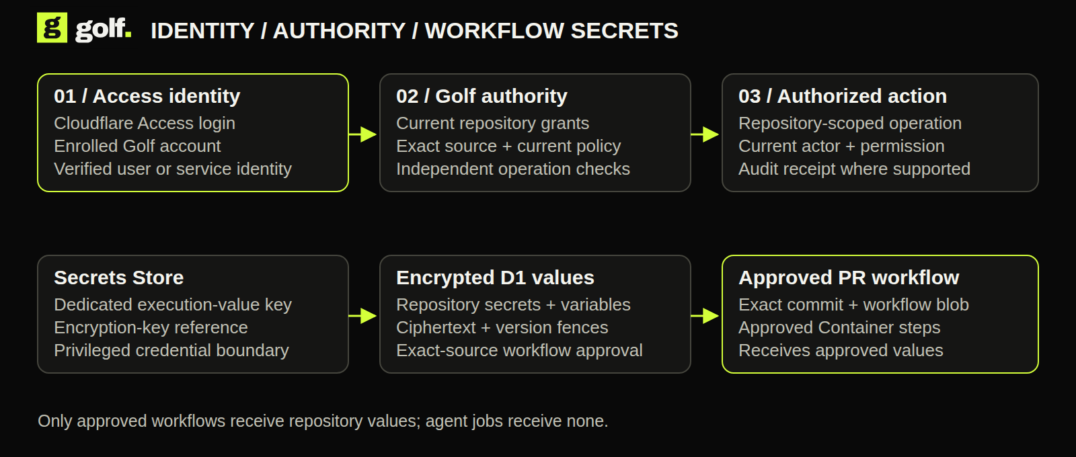
IDENTITY + DOMAINS + POLICY / THE FLOW
From identity to permission.
Release secrets only to the approved exact-commit workflow.
GOLF / DEVELOPER PREVIEW / OCTOBER 2026
18 / 29
Notes:
Account or Access administration does not override repository authority. Exact-text masking does not detect transformed secrets. Changing preview policy does not yet revoke all existing nonconforming previews. See the visual field guide for the editable source.
Reviewed product evidence: 2026-10-14. https://docs.gitgolf.app/docs/status/

Slide 19
PROTECTED DELIVERY
Review a running change.
Temporary, source-bound previews keep production separate.
01
02
Preview Worker + R2
Workers for Platforms
Broker the exact static bundle with current reader checks and expiry.
Dispatch approved modules with private per-preview D1/R2 and signing material.
03
04
Outbound Worker
Browser Run
Enforce the managed app egress policy instead of handing apps unrestricted Internet access.
Optional script-free static HTML snapshots. Full interactive application QA remains open.
GOLF / DEVELOPER PREVIEW / OCTOBER 2026
19 / 29
Notes:
Browser Run is bound in the reviewed engineering deployment but no retained ready captures existed at review. Historical disposable proof produced a real PNG. App cookies/WebSockets, arbitrary builds/bindings and production promotion remain open.
Reviewed product evidence: 2026-10-14. https://docs.gitgolf.app/docs/status/

Slide 20
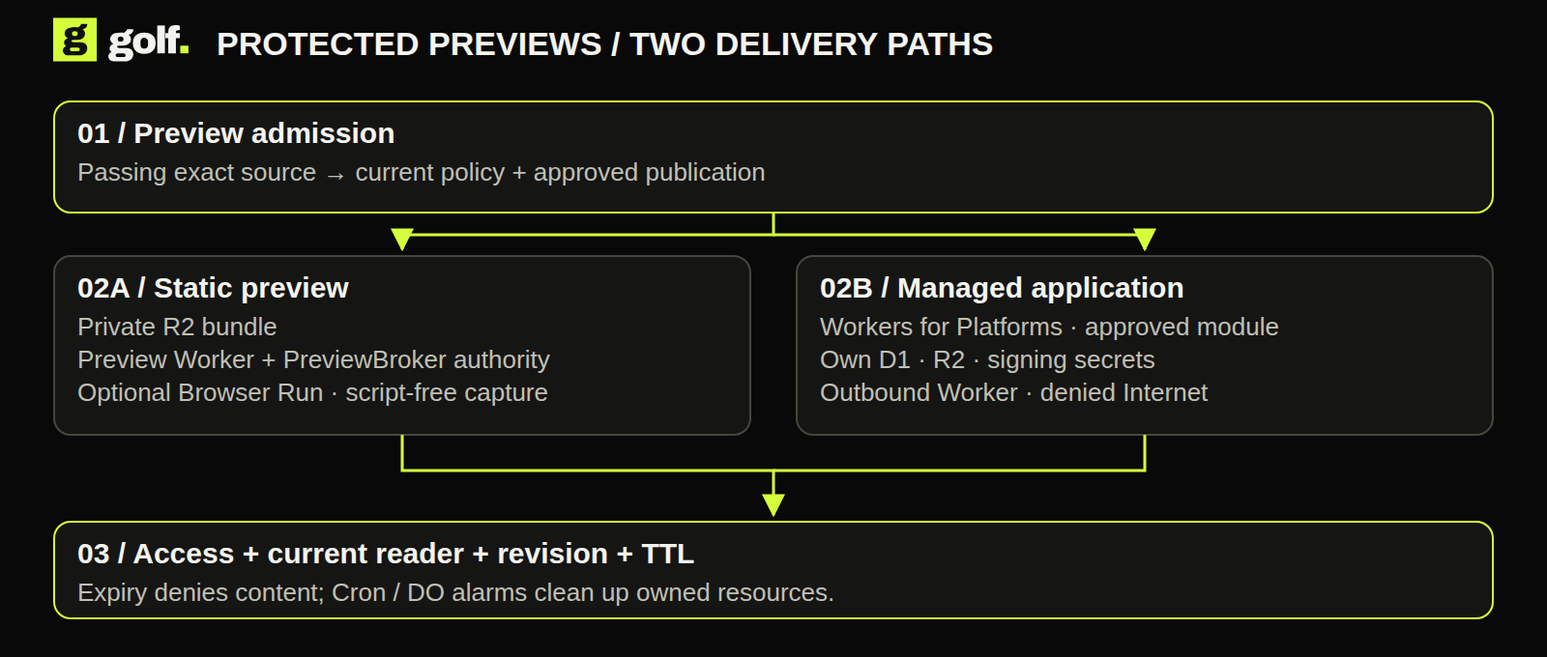
PROTECTED DELIVERY / THE FLOW
The preview has its own boundary.
Protect readers and isolate the application’s data and network access.
GOLF / DEVELOPER PREVIEW / OCTOBER 2026
20 / 29
Notes:
Browser Run is bound in the reviewed engineering deployment but no retained ready captures existed at review. Historical disposable proof produced a real PNG. App cookies/WebSockets, arbitrary builds/bindings and production promotion remain open. See the visual field guide for the editable source.
Reviewed product evidence: 2026-10-14. https://docs.gitgolf.app/docs/status/

Slide 21
WORKERS AI + AI GATEWAY
Advice and proposals have different jobs.
Optional inference serves a specific workflow.
01
02
03
Clef advice
GLM 5.3 Flash proposals
AI Gateway
Metadata-only PR reasoning through Workers AI. Advisory evidence; no approval or merge authority.
Maintained harness in an independent Artifacts fork. Approved file changes, tests and private reports.
Authenticated inference; logs and cache disabled. Configured 60/min and $5/day limits.
GOLF / DEVELOPER PREVIEW / OCTOBER 2026
21 / 29
Notes:
Retained Clef advice and a GLM 5.3 Flash proposal succeeded. The engineering proposal profile edits calc.py only. Rate/spend enforcement is configured, not exercised; no account-wide billing cap is implied.
Reviewed product evidence: 2026-10-14. https://docs.gitgolf.app/docs/status/

Slide 22
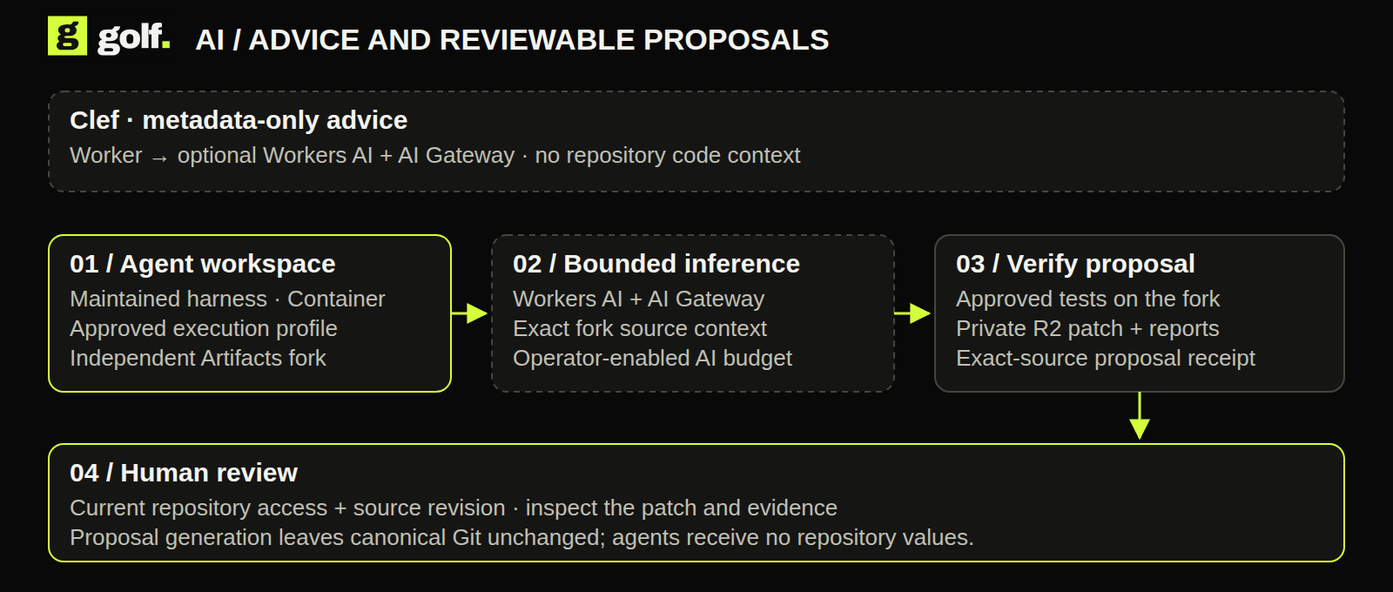
WORKERS AI + AI GATEWAY / THE FLOW
Two AI paths. Explicit authority.
Clef advice and separately tested proposals serve different jobs.
GOLF / DEVELOPER PREVIEW / OCTOBER 2026
22 / 29
Notes:
Retained Clef advice and a GLM 5.3 Flash proposal succeeded. The engineering proposal profile edits calc.py only. Rate/spend enforcement is configured, not exercised; no account-wide billing cap is implied. See the visual field guide for the editable source.
Reviewed product evidence: 2026-10-14. https://docs.gitgolf.app/docs/status/

Slide 23
EMAIL + WEBHOOKS
Keep people connected to the work.
Real messages retain consent, current access and delivery observations.
01
02
03
Email Service
Signed webhooks
D1 outboxes
Own-address subscriptions and consent; sender subdomain and DNS onboarding. Retained provider acceptance is recorded.
Encrypted subscriptions, approved origins and stable event identity. A retained Slack test delivery was accepted.
Maintenance and bounded retries carry notification delivery. These consumers do not use the evidence queue.
GOLF / DEVELOPER PREVIEW / OCTOBER 2026
23 / 29
Notes:
Email acceptance is not inbox delivery. Bounces/complaints/replies and unsubscribe lifecycle remain open. Receivers should deduplicate; an already accepted outbound effect cannot be recalled.
Reviewed product evidence: 2026-10-14. https://docs.gitgolf.app/docs/status/

Slide 24
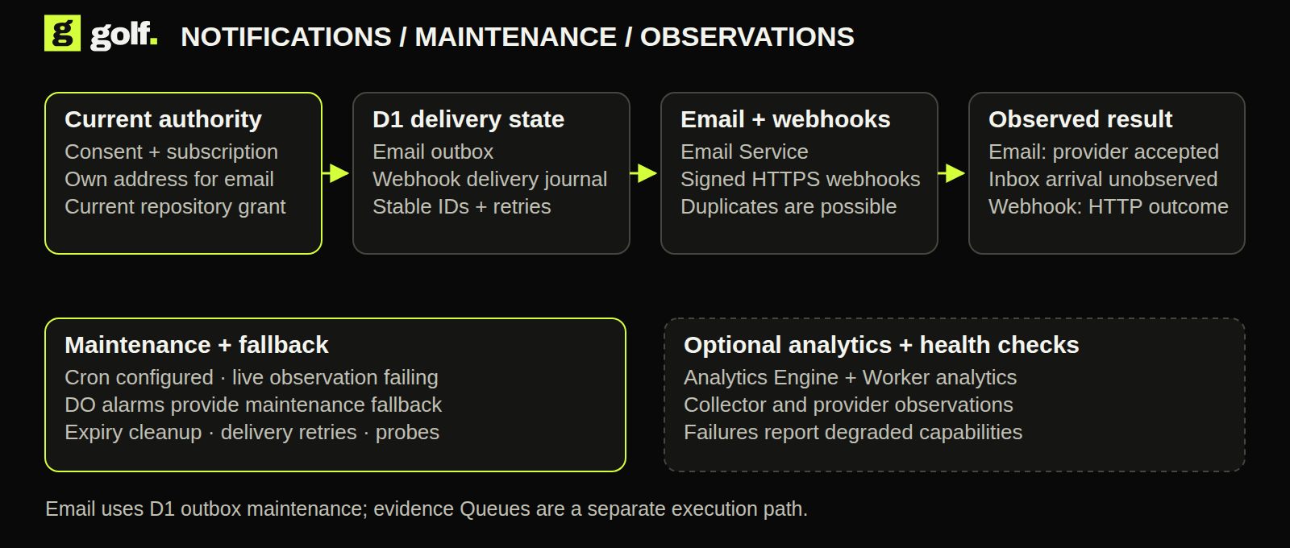
EMAIL + WEBHOOKS / THE FLOW
Keep the operating loop visible.
Separate accepted notifications from maintenance and collection health.
GOLF / DEVELOPER PREVIEW / OCTOBER 2026
24 / 29
Notes:
Email acceptance is not inbox delivery. Bounces/complaints/replies and unsubscribe lifecycle remain open. Receivers should deduplicate; an already accepted outbound effect cannot be recalled. See the visual field guide for the editable source.
Reviewed product evidence: 2026-10-14. https://docs.gitgolf.app/docs/status/

Slide 25
OPERATIONS + DEPLOYMENT
Know what is running. Know what failed.
Infrastructure definitions and actual outcomes are separate evidence.
01
02
Analytics Engine
Workers analytics + observability
Bound optional evidence metrics; hosted ingestion/readback is not yet verified.
Separate read-only analytics token and enabled provider observations; analytics collection has recorded failures.
03
04
Cron + Durable Object alarms
Alchemy + native cf CLI
Cron schedule is configured but delivery is failing on this account. Workspace alarms have completed maintenance.
Owned resource provisioning, additive schema migration, token renewal, readback and cleanup.
GOLF / DEVELOPER PREVIEW / OCTOBER 2026
25 / 29
Notes:
Read-only inspection confirmed active Worker version 44 serving 100% at review. Provider observability enabled; logpush disabled. Cron cause is unresolved; maintenance success came through the alarm fallback.
Reviewed product evidence: 2026-10-14. https://docs.gitgolf.app/docs/status/

Slide 26
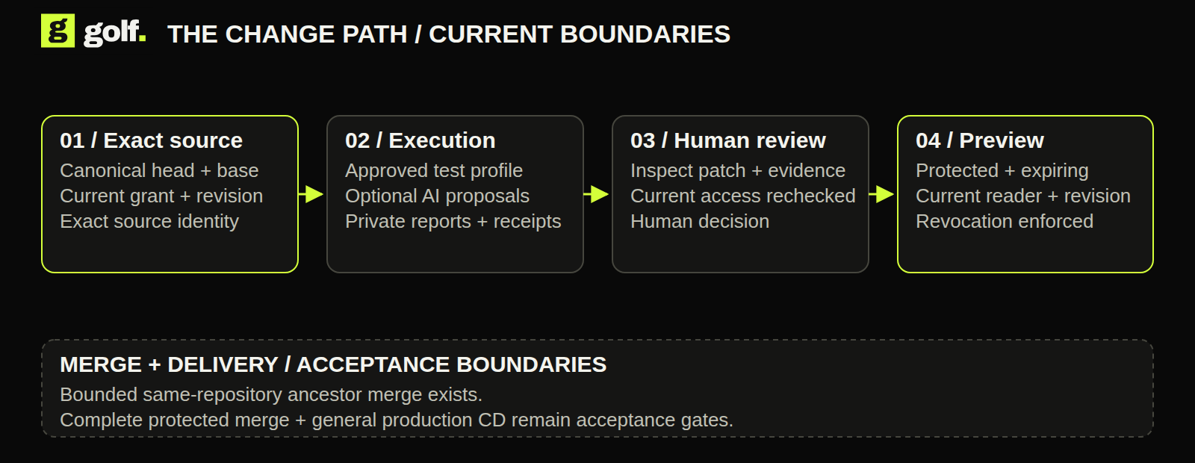
THE CHANGE PATH
Evidence before publication.
Current checks and previews are separate from broad protected merge and production delivery.
GOLF / DEVELOPER PREVIEW / OCTOBER 2026
26 / 29
Notes:
Current checks and previews are separate from broad protected merge and production delivery.
Reviewed product evidence: 2026-10-14. https://docs.gitgolf.app/docs/status/

Slide 27
IN DEVELOPMENT / VECTORIZE
Search beyond exact matches.
Semantic code and issue search is being added.
01
02
03
Workers AI embeddings
Vectorize
Current reader access
Create semantic representations from approved source content.
Index and query those representations to find related code and issues.
Filter results by live repository authority and propagate deletion/revocation.
GOLF / DEVELOPER PREVIEW / OCTOBER 2026
27 / 29
Notes:
This is in development per the product owner. No Vectorize binding or accepted semantic-search path was found in the reviewed engineering deployment. AI Search is not implied.
Reviewed product evidence: 2026-10-14. https://docs.gitgolf.app/docs/status/

Slide 28
CURRENT QUALIFICATION
A developer preview with real evidence.
Dated engineering proofs cover selected Git, test, proposal and protected-preview paths. Production readiness still needs testing.
01
02
03
Demonstrated
Incomplete or degraded
Next acceptance
Hosted Git, collaboration, approved tests, Clef advice, scoped proposals, protected previews, email acceptance and secret-to-step delivery.
Cron delivery and analytics collection; Analytics Engine ingest; retained screenshots; broader role/load/cleanup matrices.
Full parity, protected merge, production CD, native/Forgejo recovery, tenant onboarding and scale. Vectorize search is in development.
GOLF / DEVELOPER PREVIEW / OCTOBER 2026
28 / 29
Notes:
Dated engineering proofs cover selected Git, test, proposal and protected-preview paths. Production readiness still needs testing.
Reviewed product evidence: 2026-10-14. https://docs.gitgolf.app/docs/status/

Slide 29
YOUR NEXT MOVE
Try Golf for yourself.
Start with a browser simulation, then install Golf to evaluate real workflows.
01
02
03
Browser simulations
Choose your deployment
Evaluate real work
gitgolf.app/demo: explore local and Cloudflare interfaces with sample data. No backend or live execution.
Docker Compose or Golf’s Helm chart for portable hosting. Use the native Alchemy recipe in your own Cloudflare account.
Enroll a user and grant repository access on your installation. Check an exact commit and inspect its report. docs.gitgolf.app
GOLF / DEVELOPER PREVIEW / OCTOBER 2026
29 / 29
Notes:
All deployment instructions and current capability limits are in the documentation. Private source checkout requires repository access. Product provisioning creates real account resources and costs. Links: https://gitgolf.app/try and https://docs.gitgolf.app/docs/getting-started/.
Reviewed product evidence: 2026-10-14. https://docs.gitgolf.app/docs/status/

